Slide 1
6.3 Dividing Polynomials

Slide 2
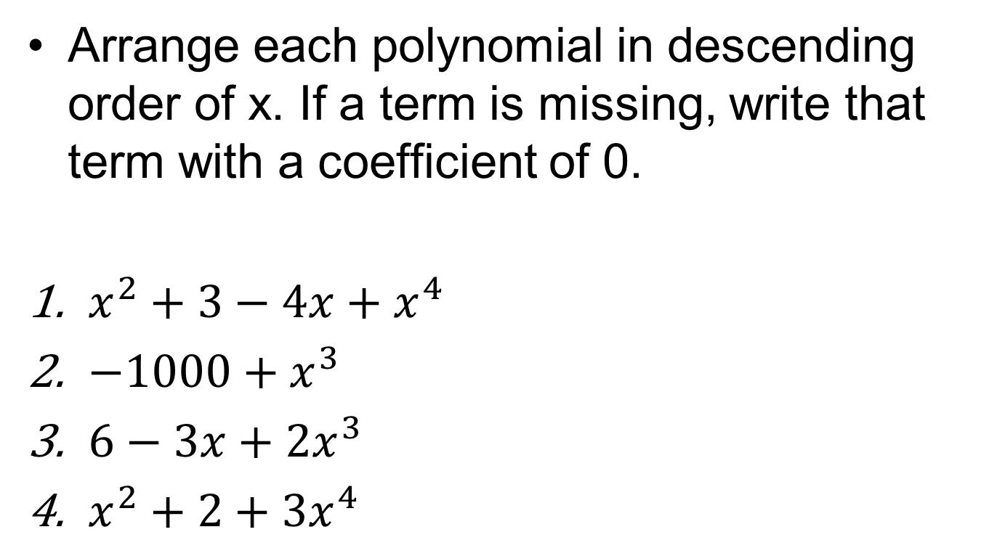
Do now!
Arrange each polynomial in descending order of x. If a term is missing, write that term with a coefficient of 0.
$x^{2}+3−4x+x^{4}$
$−1000+x^{3}$
$6−3x+2x^{3}$
$x^{2}+2+3x^{4}$

Slide 3
Objectives:
Define and use the division algorithm for polynomials.
Define and use the Fundamental Theorem of Algebra to find the zeros of a polynomial function.

Slide 4
Introduction:
If you know the zeros of a polynomial, you can write the polynomial in factored form.
If a graph cannot be used to determine the zeros, we can use DIVISION to find our remaining factors!

Slide 5
Warm Up
Without a calculator, divide the following
Solution: 49251

Slide 6
The Division Algorithm
When 17 is divided by 3…
5
3 17
-15
2
Quotient = 5
Remainder = 2
This can be written as: 17 = 5x3 + 2

Slide 7
The Division Algorithm
When 18 is divided by 3…
6
3 18
-18
0
Quotient = 6
Remainder = 0
This can be written as: 18 = 6x3 + 0

Slide 8
This can also be applied to POLYNOMIALS…

Slide 9
The Division Algorithm
When polynomial P is divided by polynomial D…
Q with a remainder of R
D P
Quotient = Q
Remainder with a degree less than D = R
This can be written as: P = DQ + R
If R = 0, then D divides P EXACTLY.

Slide 10
Example 1: Use the division algorithm to divide the polynomials.
a) (5x³ -13x² +10x -8) / (x-2)
5x²
- 3x
+ 4
R 0
x - 2
5x³ - 13x² + 10x - 8
-
(
5x³ - 10x²
)
-3x²
+ 10x
-
(
-3x² + 6x
)
4x
- 8
-
(
4x - 8
)
0

Slide 11
So in other words…
5x³ -13x² +10x - 8
=
5x² -3x + 4
x-2
OR
(5x² -3x + 4)
(x-2)
=
5x³ -13x² +10x - 8

Slide 12
Example 1: Use the division algorithm to divide the polynomials.
b) (x² +3x -12) / (x – 3)
x
+ 6
R 6
x - 3
x² + 3x - 12
-
(
x² - 3x
)
6x
-12
-
(
6x - 18
)
6

Slide 13
So in other words…
x² +3x -12
=
X+6 with a remainder of 6
x – 3
OR
(x – 3)(x + 6) + 6
=
x² +3x -12

Slide 14
Example 2: Let’s Try One
(2x² -19x + 8) / (x-8)
x - 8
2x² - 19x + 8

Slide 15
Example 2: Let’s Try One
(2x² -19x + 8) / (x-8)
x - 8
2x² - 19x + 8

Slide 16
Classwork/Homework
Dividing Polynomials Packet

Slide 17
Example 3: Use the division algorithm to divide the polynomials.
(x³ - 216) / (x – 6)
x²
+ 6x
+ 36
R 0
x - 6
x³ + 0x² + 0x - 216
-
(
x³ - 6x²
)
6x²
+ 0x
-
(
6x² - 36x
)
36x
- 216
-
(
36x - 216
)
0

Slide 18
So in other words…
x³ - 216
=
x² + 6x + 36
Factored over the real numbers!
x – 6
OR
x³ - 216
=
(x – 6)(x² + 6x + 36)
Note: x² + 6x + 36 cannot be factored over the real numbers. The roots are complex and it is PRIME with respect to the real numbers.

Slide 19
Difference of Two Cubes
x³ - 216 is an example of a difference of two cubes.
x³ - b³ = (x – b)(x² + bx + b²)
What about the sum of two cubes?
x³ + b³ = ?
How do you think it is factored?
Use the division algorithm to write a general rule for factoring the sum of cubes. →

Slide 20
Sum of Cubes
(x³ + a³) / (x + a)
x²
- ax
+ a²
R 0
x + a
x³ + 0x² + 0x + a³
-
(
x³ + ax²
)
-ax²
+ 0x
-
(
-ax² - a²x
)
a²x
+ a³
-
(
a²x + a³
)
0
x³ + a³ = (x + a)(x² - ax + a²)
→

Slide 21
Summary: The sum or difference of two cubes will factor into a binomial × trinomial.
same sign
always +
always opposite
same sign
always +
always opposite

Slide 22
Now we know how to get the signs, let’s work on
what goes inside.
Square this term to get this term.
Cube root of 1st term
Cube root of 2nd term
Product of cube root of 1st term
and cube root of 2nd term.

Slide 23
Example 4: Try one.
Factor. Make a binomial and a trinomial with the correct signs.

Slide 24
Example 4: Try one.
Cube root of 1st term
Cube root of 2nd term

Slide 25
Example 4: Try one.
Square this term to get this term.

Slide 26
Example 4: Try one.
Multiply 3x an 5 to get this term.

Slide 27
Example 4: Try one.
Square this term to get this term.

Slide 28
Example 4: Try one.
You did it!

Slide 29
Classwork/Homework
Factoring the Sum or Difference of Cubes Worksheet

Slide 30
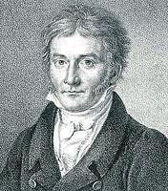
A Little Bit of History:
At the age of 20, the German mathematician Karl Frederick Gauss, 1777-1855, earned his Ph. D. by proving that every polynomial equation has at least one root.

Slide 31
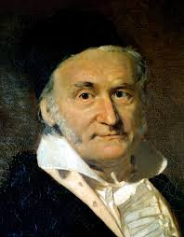
A Little Bit of History:
The root may be real, imaginary, or complex.
The proof is beyond the scope of this book, but it stands as one of the most outstanding accomplishments of modern mathematics.

Slide 32
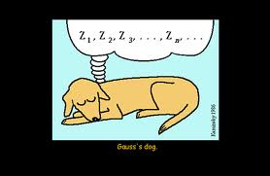
A Little Bit of History:
The theorem that Gauss proved is called the Fundamental Theorem of Algebra.

Slide 33
The Fundamental Theorem of Algebra
Every polynomial function of degree n > 0 has at least one complex zero.

Slide 34
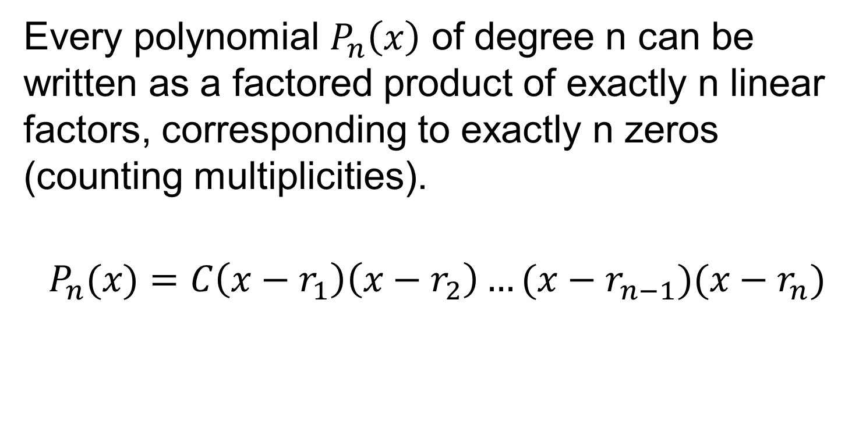
The Number of Polynomial Roots
Every polynomial $P_{n}\left(x\right)$ of degree n can be written as a factored product of exactly n linear factors, corresponding to exactly n zeros (counting multiplicities).
$$P_{n}(x)=C\left(x−r_{1}\right)\left(x−r_{2}\right)…(x−r_{n−1})(x−r_{n})$$

Slide 35
If a polynomial has one complex root, then its complex conjugate is also a root.
A polynomial of odd degree, n, may have at most an even number, n-1, of complex factors.
Every polynomial of odd degree has at least one real root.

Slide 36
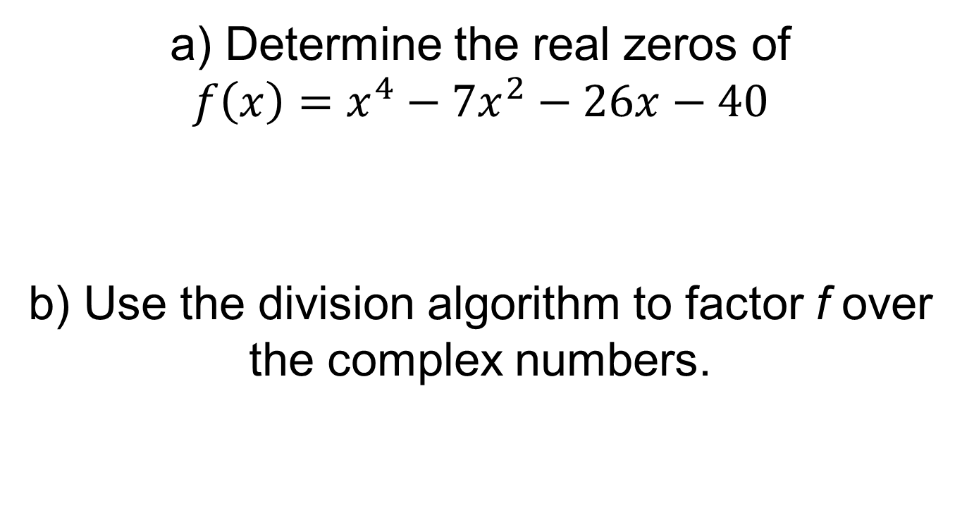
Example 5:
a) Determine the real zeros of
$$f\left(x\right)=x^{4}−7x^{2}−26x−40$$
b) Use the division algorithm to factor f over the complex numbers.

Slide 37
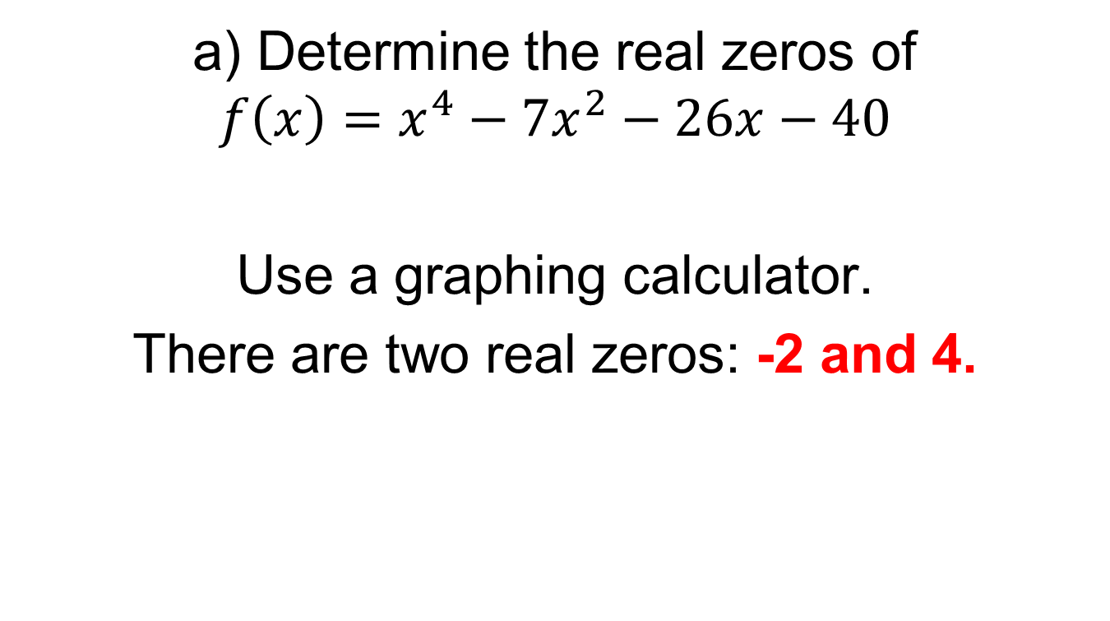
Example 5:
a) Determine the real zeros of
$$f\left(x\right)=x^{4}−7x^{2}−26x−40$$
Use a graphing calculator.
There are two real zeros: -2 and 4.

Slide 38
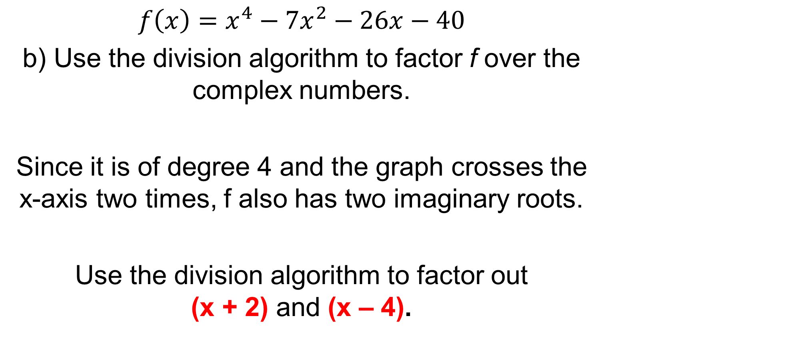
Example 5:
$$f\left(x\right)=x^{4}−7x^{2}−26x−40$$
b) Use the division algorithm to factor f over the complex numbers.
Since it is of degree 4 and the graph crosses the x-axis two times, f also has two imaginary roots.
Use the division algorithm to factor out (x + 2) and (x – 4).

Slide 39
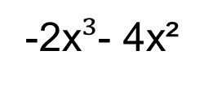
Use the division algorithm to divide the polynomials.
(x⁴ – 7x² – 26x – 40) / (x + 2)
x³
- 2x²
- 3x
- 20
x + 2
x⁴ + 0x³ – 7x² – 26x – 40
-
(
x⁴ + 2x³
)
-2x³
-7x²
-
(
-2x$³$- 4x²
)
-3x²
- 26x
-
(
-3x² - 6x
)
-20x
- 40
-
(
)
-20x - 40
0

Slide 40
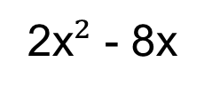
So we now have x⁴ – 7x² – 26x – 40 = (x + 2)(x³ - 2x² - 3x – 20)
Now Factor out (x – 4)
(x³ - 2x² - 3x – 20) / (x – 4)
x²
+ 2x
+ 5
x - 4
x³ - 2x² – 3x – 20
-
(
x³ - 4x²
)
2x²
- 3x
-
(
2x$²$ - 8x
)
5x
- 20
-
(
5x - 20
)
0

Slide 41
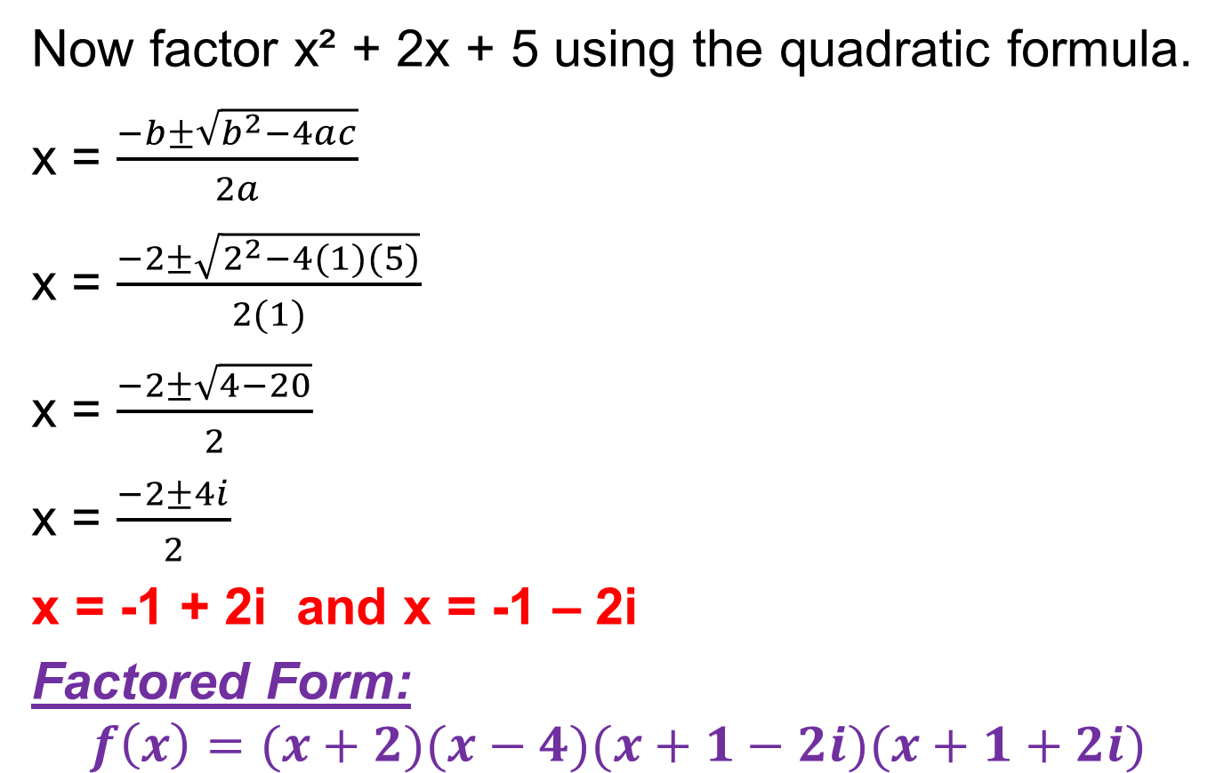
So we now have x⁴ – 7x² – 26x – 40 = (x + 2)(x - 4)(x² + 2x + 5)
Now factor x² + 2x + 5 using the quadratic formula.
x = $\frac{−b±\sqrt{b^{2}−4ac}}{2a}$
x = $\frac{−2±\sqrt{2^{2}−4(1)(5)}}{2(1)}$
x = $\frac{−2±\sqrt{4−20}}{2}$
x = $\frac{−2±4i}{2}$
x = -1 + 2i and x = -1 – 2i
Factored Form:
$$f\left(x\right)=(x+2)(x−4)(x+1−2i)(x+1+2i)$$

Slide 42
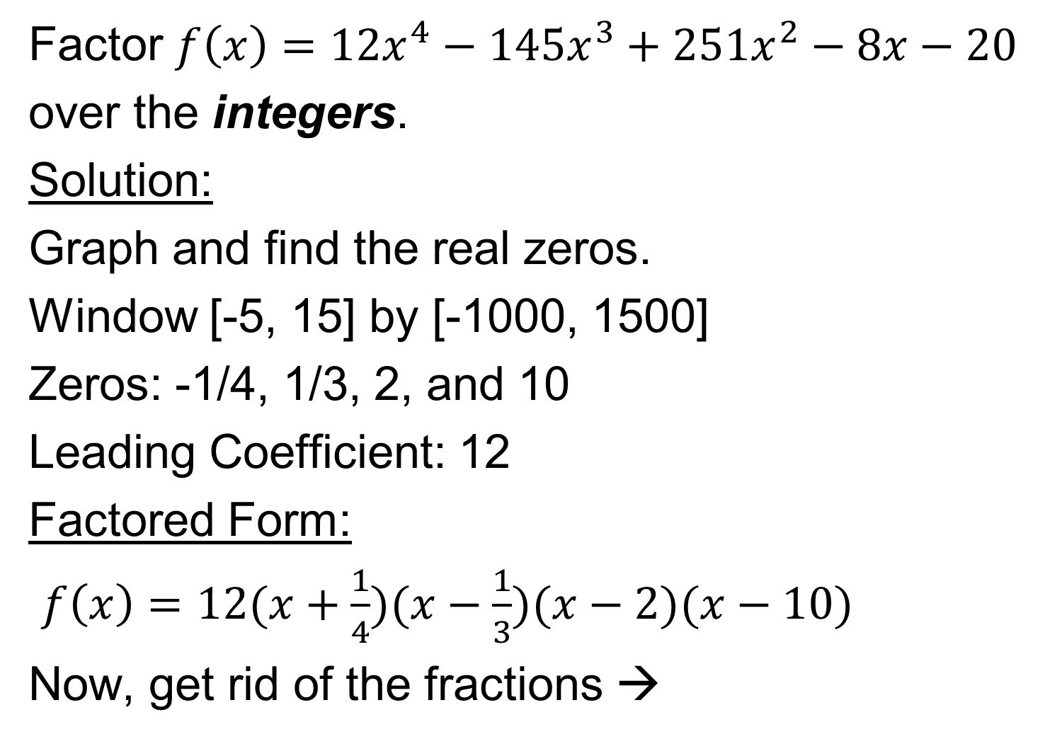
Example 6:
Factor $f\left(x\right)=12x^{4}−145x^{3}+251x^{2}−8x−20$
over the integers.
Solution:
Graph and find the real zeros.
Window [-5, 15] by [-1000, 1500]
Zeros: -1/4, 1/3, 2, and 10
Leading Coefficient: 12
Factored Form:
$f\left(x\right)=12(x+\frac{1}{4})(x−\frac{1}{3})(x−2)(x−10)$
Now, get rid of the fractions →

Slide 43
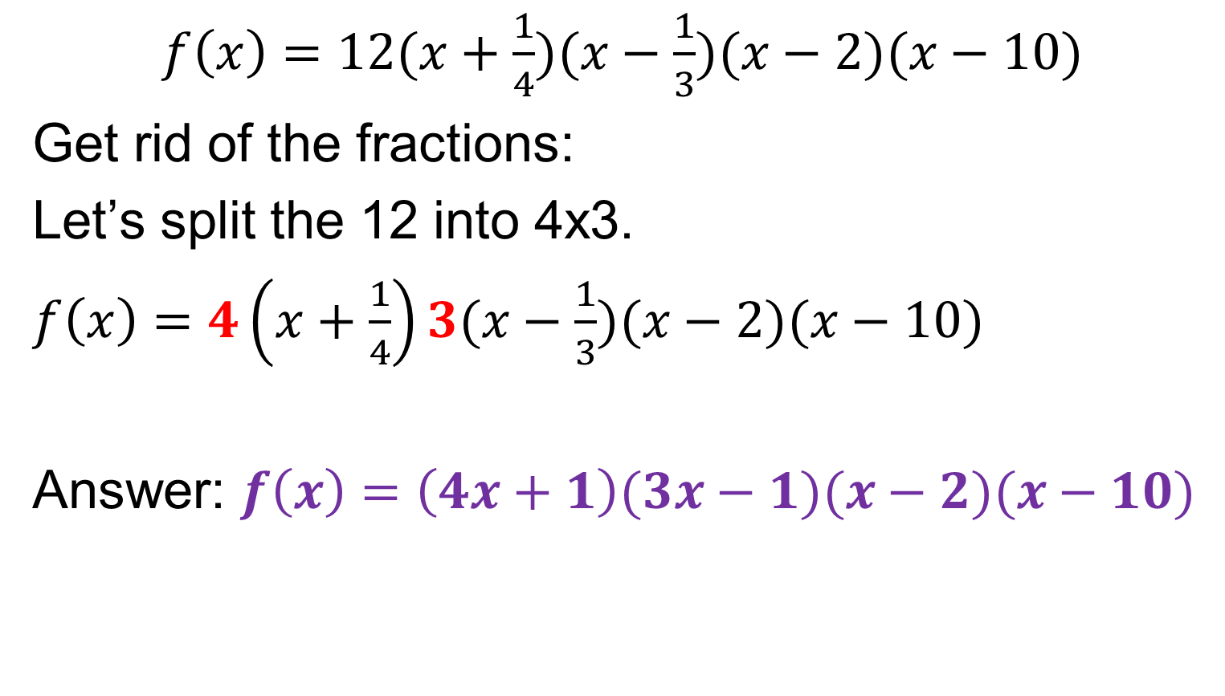
Example 6:
$f\left(x\right)=12(x+\frac{1}{4})(x−\frac{1}{3})(x−2)(x−10)$
Get rid of the fractions:
Let’s split the 12 into 4x3.
$f\left(x\right)=4\left(x+\frac{1}{4}\right)3(x−\frac{1}{3})(x−2)(x−10)$
Answer: $f\left(x\right)=\left(4x+1\right)(3x−1)(x−2)(x−10)$

Slide 44
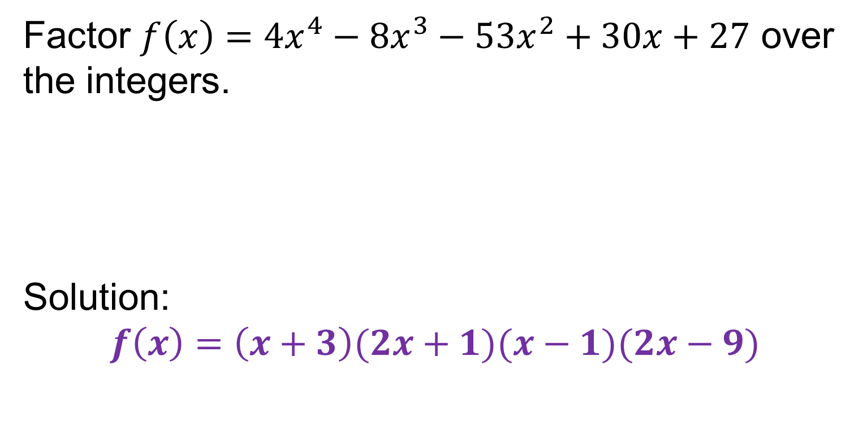
On your own.
Factor $f\left(x\right)=4x^{4}−8x^{3}−53x^{2}+30x+27$ over the integers.
Solution:
$$f\left(x\right)=\left(x+3\right)(2x+1)(x−1)(2x−9)$$

Slide 45
Homework
Section 6.3 Worksheet – Factoring higher degree polynomials.

Slide 46
Synthetic Division
This is a more compact form of division.
It can also be used to divide polynomials without writing out all the steps of long division.

Slide 47
EX – Synthetic division
(5x³ -13x² +10x -8) / (x-2)
Opposite
of number in
divisor
2
5 -13 10 -8
10
-6
8
5
-3
4
0
5x² -3x + 4

Slide 48
EX – Synthetic division
(3x³ -4x² +2x -1) / (x+1)
Opposite
of number in
divisor
-1
3 -4 2 -1
-3
+7
-9
3
-7
9
-10
3x² -7x + 9 R-10

Slide 49
Let’s Try One
(x³ -13x +12) / (x+4)

Slide 50
EX – Synthetic division
(x³ -13x +12) / (x+4)
Opposite
of number in
divisor

Slide 51
A Couple of Notes
Use synthetic division when the coefficient in front of x is 1
  (x- 2) (2x-3)
YES
NO
Test → If a binomial is a factor, you get a remainder of zero
If you get a remainder, the answer is not a factor.

Slide 52
From this example, x-8 IS a factor because the remainder is zero
(2x² -19x + 8) / (x-8)
x - 8
2x² - 19x + 8

Slide 53
In this case, x-3 is not a factor because there was a remainder of 6
x
+ 6
R 6
x - 3
x² + 3x - 12
-
(
x² - 3x
)
6x
-12
-
(
6x - 18
)
6

Slide 54
Classwork:
Synthetic Division Worksheet

Slide 55
Homework:
6.3 Practice and Apply

